Slide 1
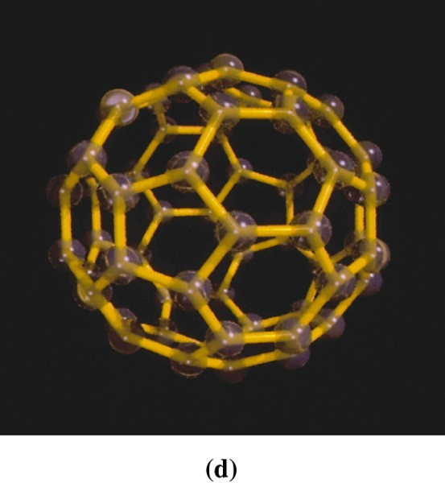
Chapter 13: Liquids, Solids and
Intermolecular Forces
General Chemistry
Principles and Modern Applications
Petrucci • Harwood • Herring
8th Edition
Philip Dutton
University of Windsor, Canada
N9B 3P4
Prentice-Hall © 2002

Slide 2
Contents
13-1 Intermolecular Forces and some Properties of Liquids
13-2 Vaporization of Liquids: Vapor Pressure
13-3 Some Properties of Solids
13-4 Phase Diagrams
13-5 Van der Waals Forces
13-6 Hydrogen Bonding
13-7 Chemical Bonds as Intermolecular Forces
13-8 Crystal structures
13-8 Energy Changes in the Formation of Ionic Crystals
Focus on Liquid Crystals

Slide 3
13-1 Intermolecular Forces and Some Properties of Liquids
Cohesive Forces
  Intermolecular forces between like molecules.
Adhesive Forces
  Intermolecular forces between unlike molecules.
Surface Tension
  Energy or work required to increase the surface area of a liquid.
Viscosity
  A liquids resistance to flow

Slide 4
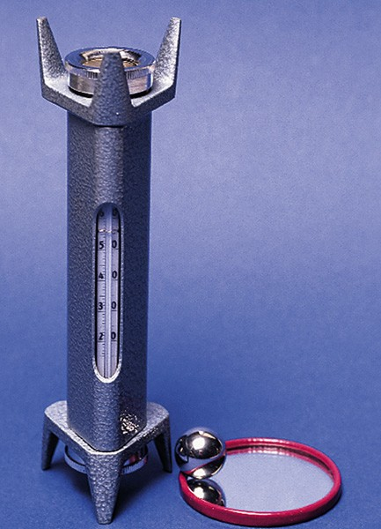
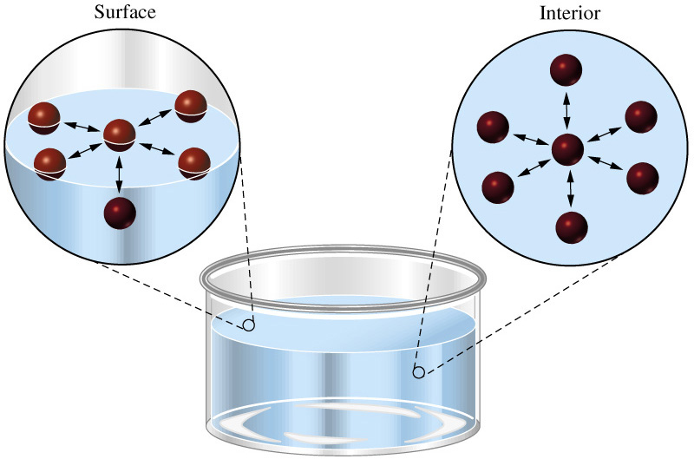
Intermolecular Forces

Slide 5
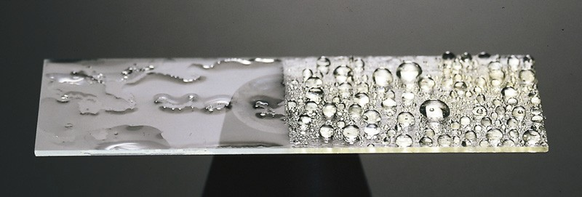
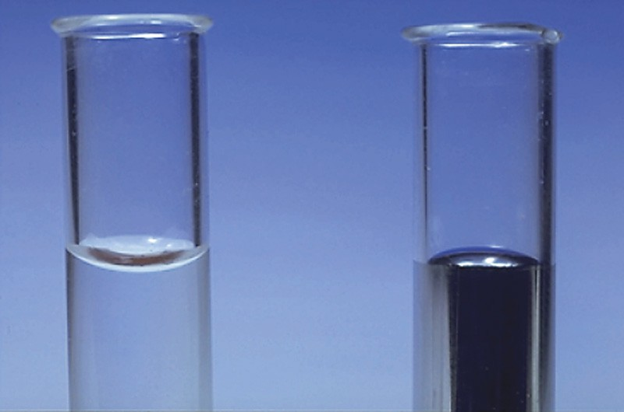
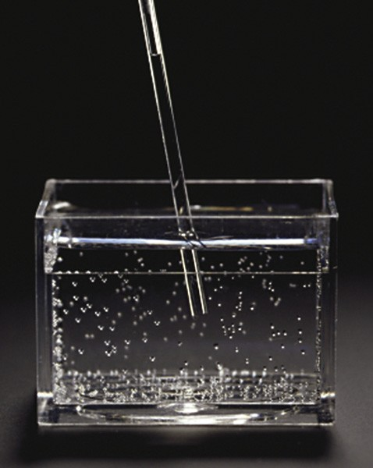
Intermolecular Forces

Slide 6
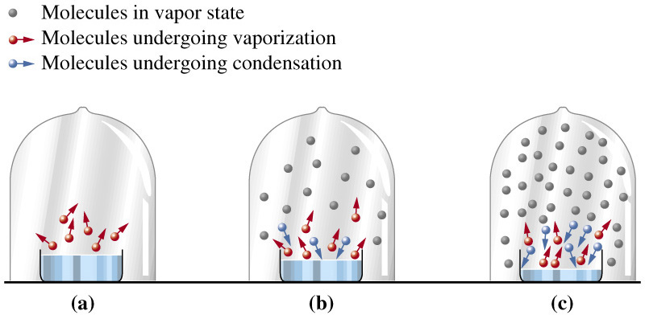
13-2 Vaporization of Liquids:
Vapor Pressure
Notes:
Bonding atomic orbitals are shown in grey.

Slide 7
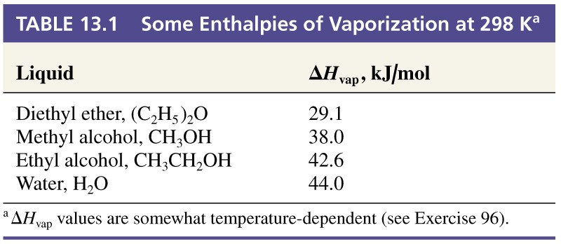
Enthalpy of Vaporization
ΔH_{vap} = H_{vapor} – H_{liquid} = - ΔH_{condensation}

Slide 8
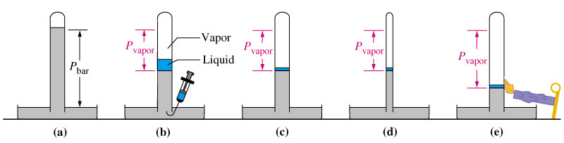
Boiling Point
Mercury manometer
Vapor pressure of liquid
P_{vap} independent of V_{liq}
P_{vap} independent of V_{gas}
P_{vap} dependent on T

Slide 9
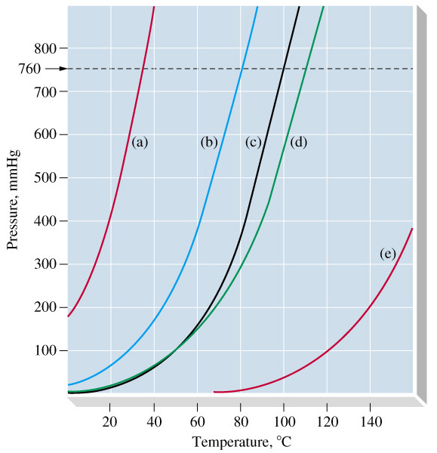
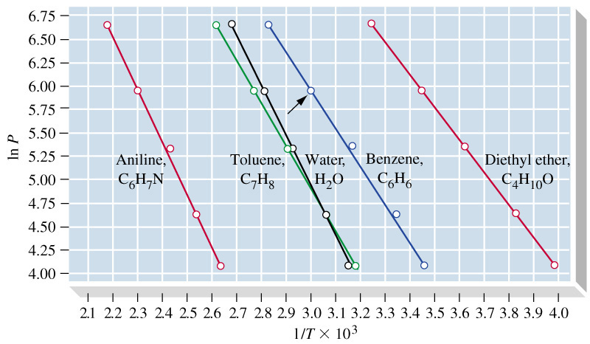
Vapor Pressure and Boiling Point
(e) (d) (c) (b) (a)
1
Ln P = -A ( ) + B
T
ΔH_{vap}
A =
R

Slide 10
Clausius-Clapeyron Equation
1
Ln P = -A ( ) + B
T
P₂
ΔH_{vap}
1
1
Ln = - ( - )
P₁
R
T₁
T₂

Slide 11
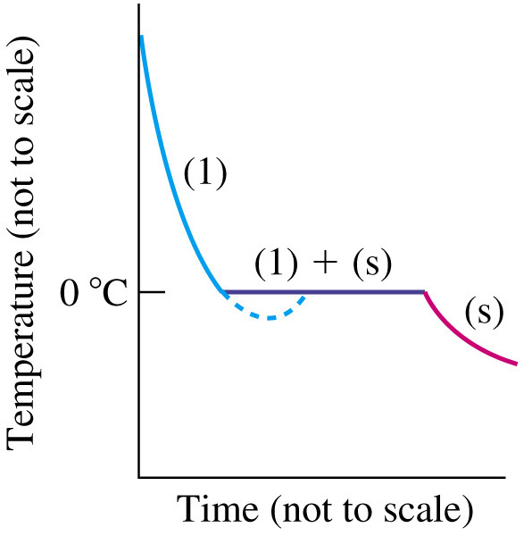
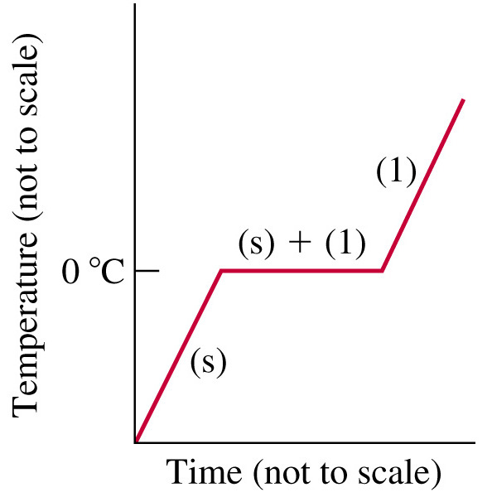
13-3 Some Properties of Solids
Freezing Point
Melting Point
ΔH_{fus}(H₂O) = +6.01 kJ/mol

Slide 12
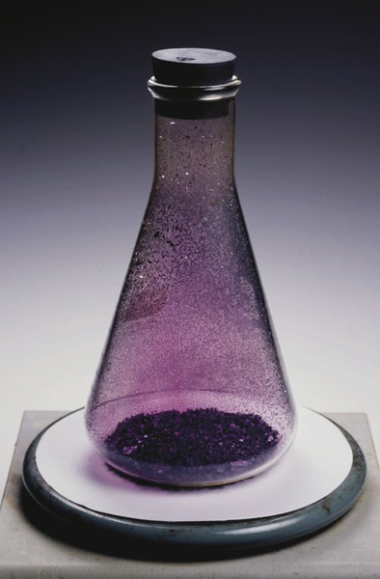
Sublimation
ΔH_{sub} = ΔH_{fus} + ΔH_{vap}
= -ΔH_{deposition}

Slide 13
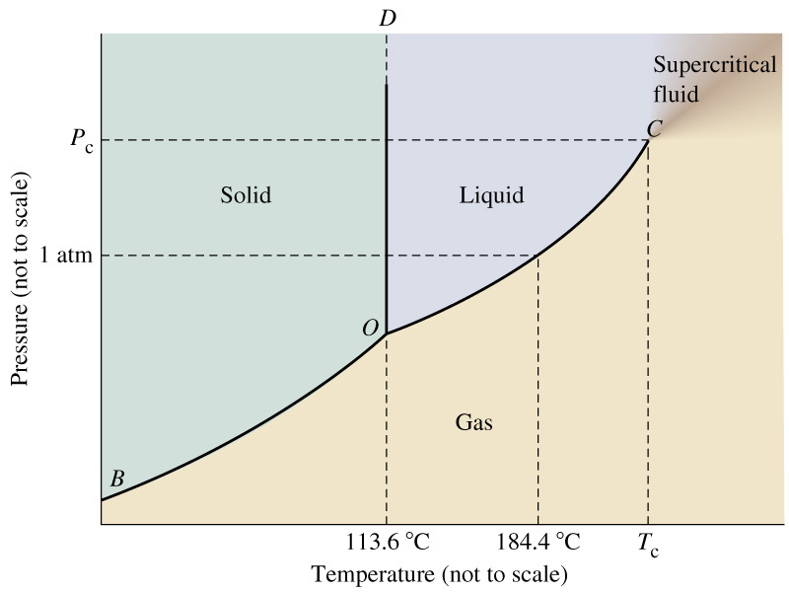
13-4 Phase Diagrams
Iodine
Notes:
OD represents the FUSION CURVE. There is little effect of pressure on melting point.
O is the triple point. A unique temperature and pressure at which three states of matter coexist.

Slide 14
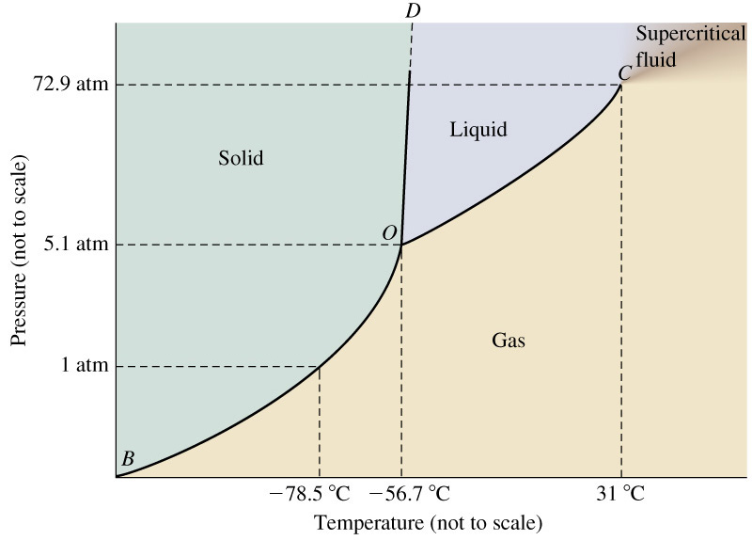
Phase Diagrams
Carbon dioxide
Notes:
Triple point is greater than one atmosphere, so we do not form liquid. Sublimation occurs.
Liquid present in fire extinguishers (P > 5.1 atm)

Slide 15
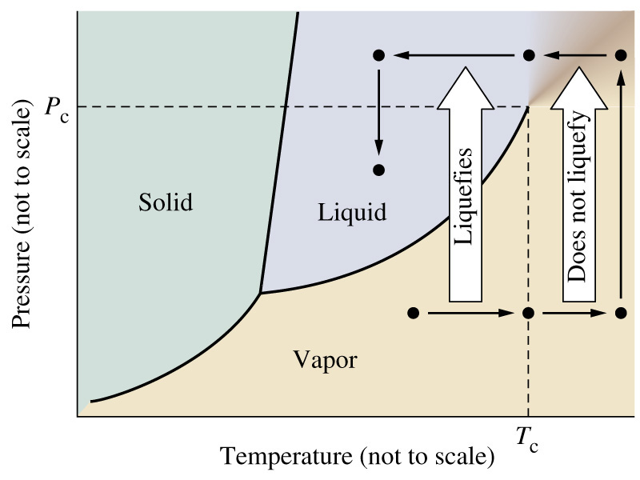
Supercritical Fluids

Slide 16
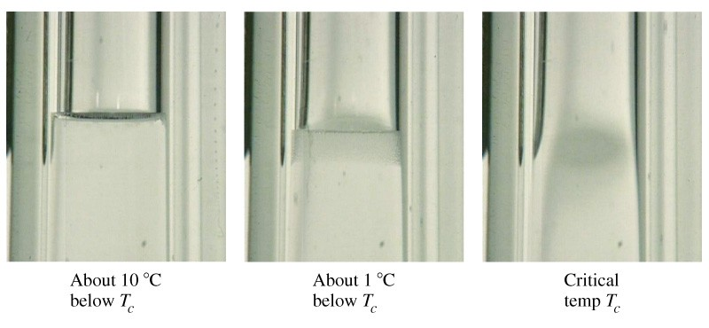
The Critical Point

Slide 17
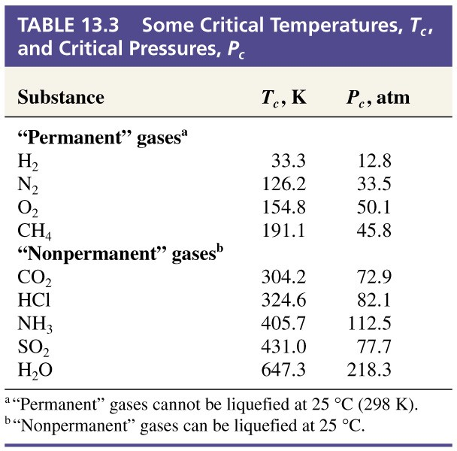
Critical Temperatures and Pressures

Slide 18
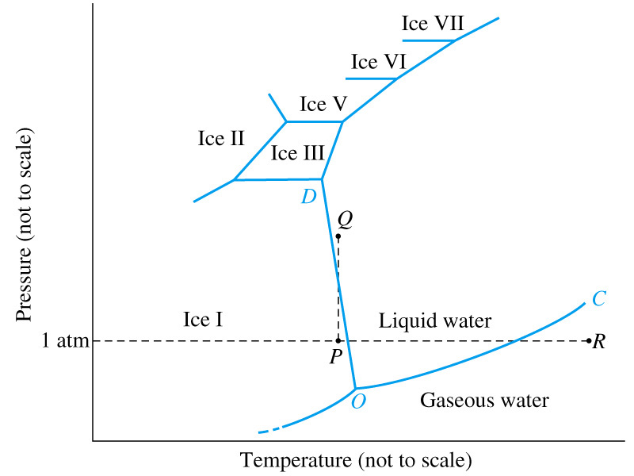
Water
Notes:
Fusion curve (OD) has a negative slope. Unusual behavior. Ice skating.
Polymorphysm, the existence of a solid substance in more than one form. This is common.

Slide 19
13-5 Van der Waals Forces
Instantaneous dipoles.
  Electrons move in an orbital to cause a polarization.
Induced dipoles.
  Electrons move in response to an outside force.
Dispersion or London forces.
  Instaneous dipole – induced dipole attraction.
  Related to polarizability.

Slide 20
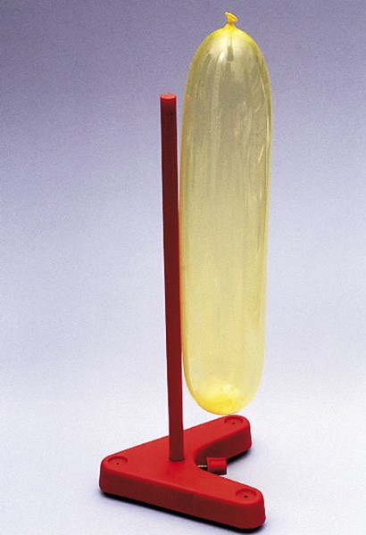
Phenomenon of Induction

Slide 21
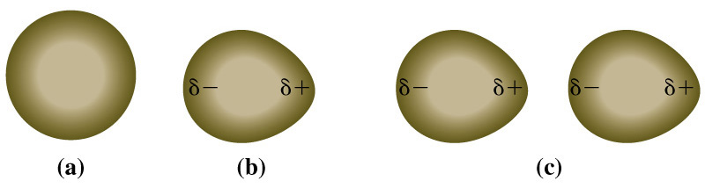
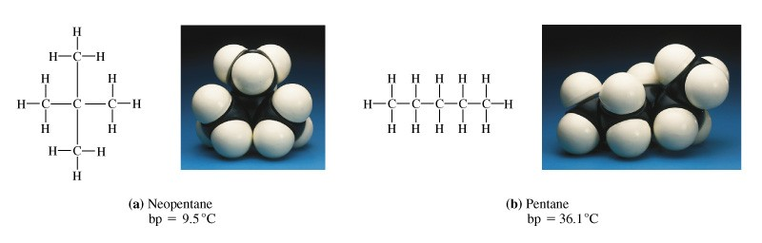
Instantaneous and Induced Dipoles

Slide 22
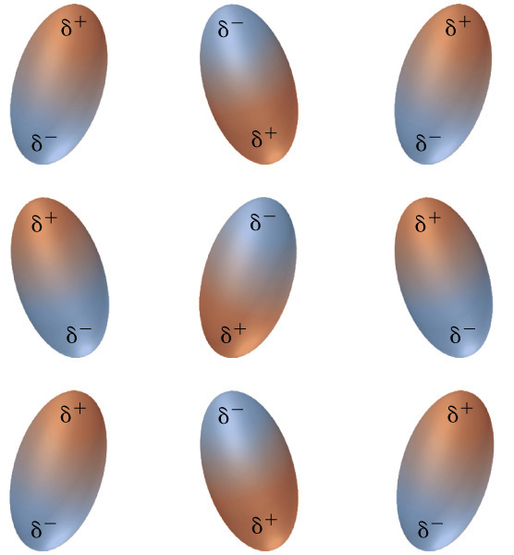
Dipole Dipole Interactions

Slide 23
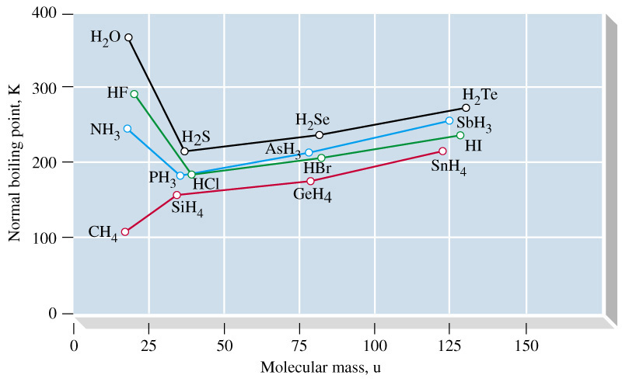
13-6 Hydrogen Bonding

Slide 24
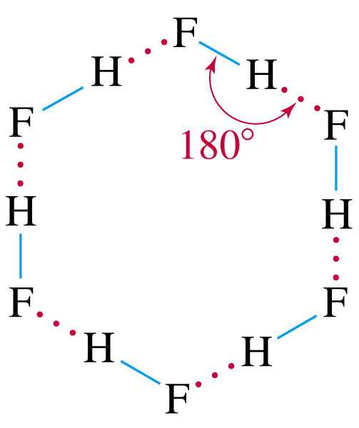
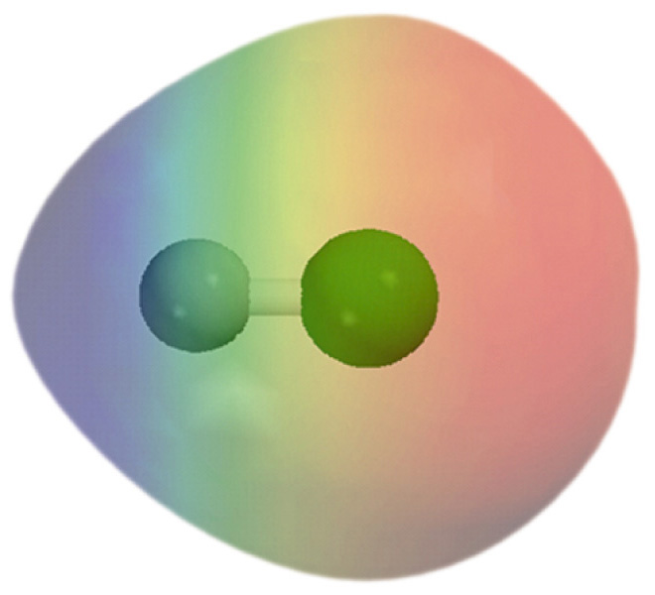
Hydrogen Bonding in HF(g)

Slide 25
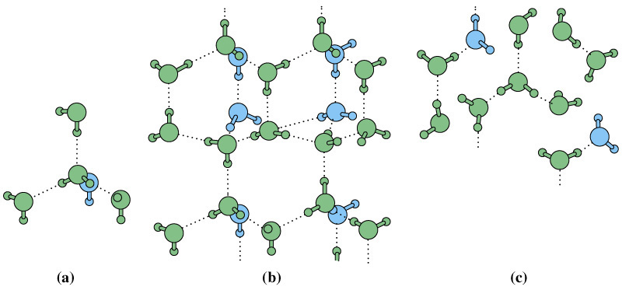
Hydrogen Bonding in Water
around a molecule in the solid in the liquid
Notes:
Solid ice has lower density than liquid water. H-bonding holds the ice in a rigid but open structure.
Maximum density of water at 3.98 C.

Slide 26
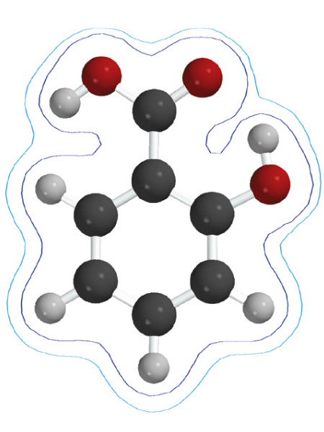
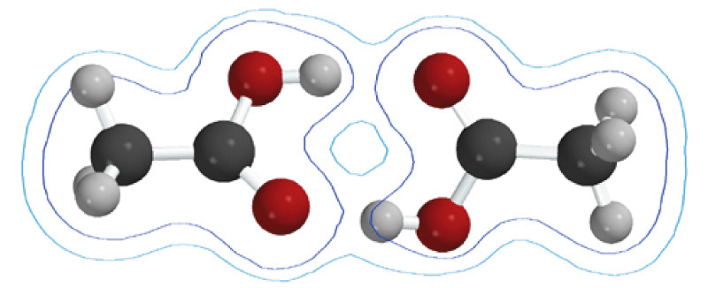
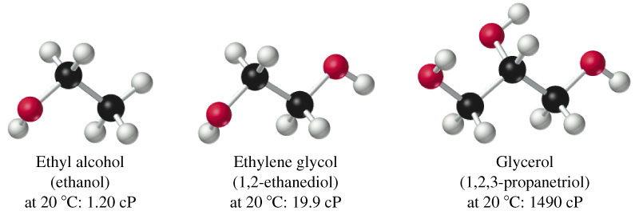
Other examples of H-Bonds

Slide 27
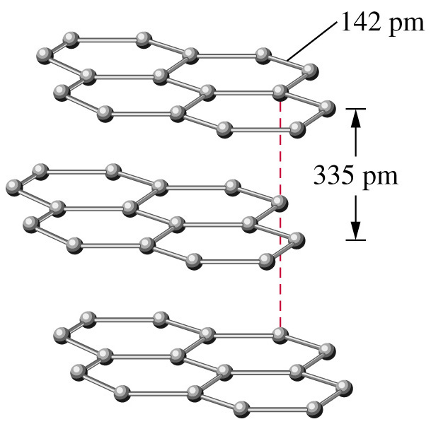
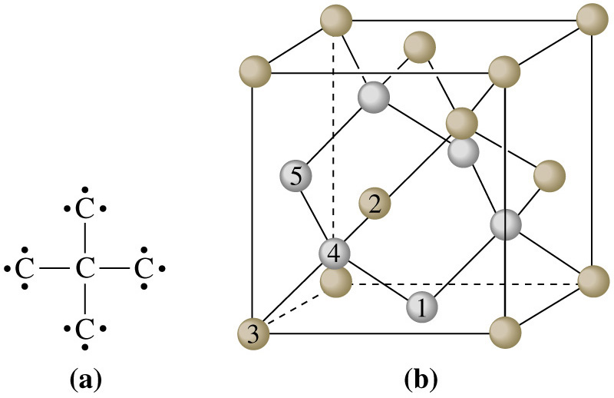
13-7 Chemical Bonds as
Intermolecular Forces
Notes:
Network covalent solids. C allotropes: Diamond and Graphite

Slide 28
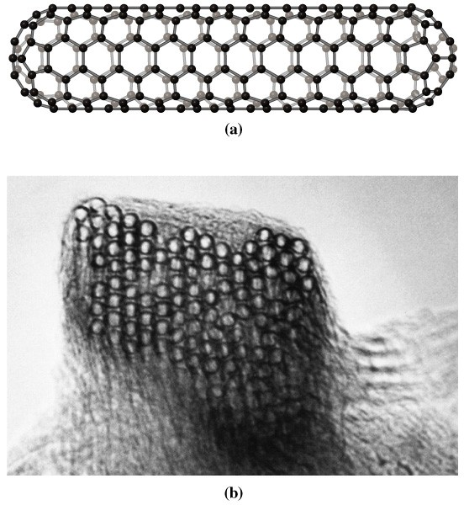
Other Carbon Allotropes

Slide 29
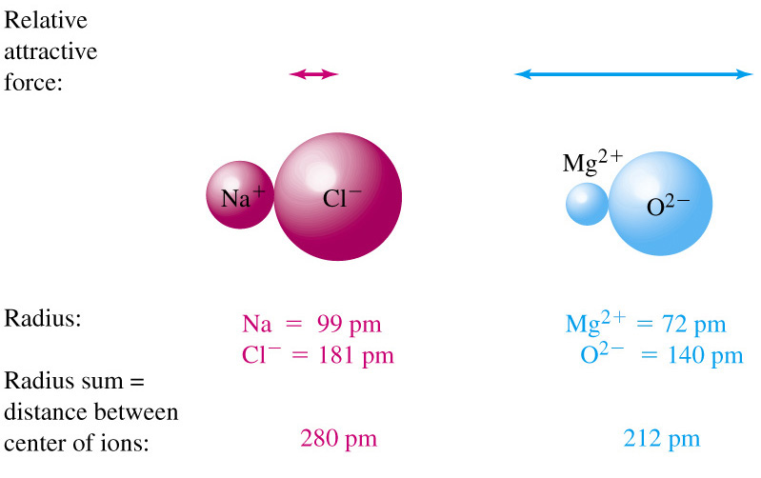
Interionic Forces

Slide 30
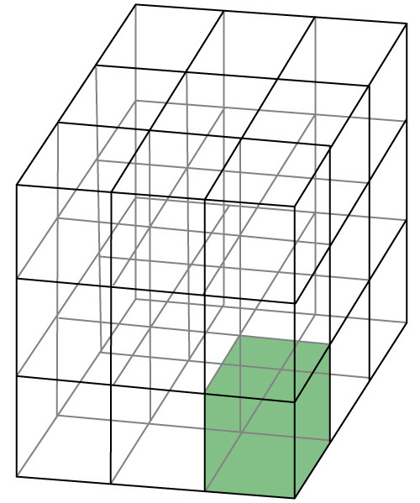
13-8 Crystal Structures

Slide 31
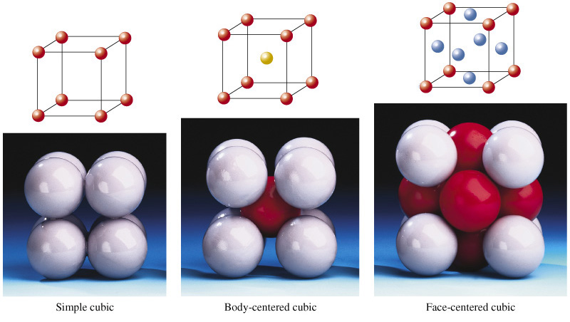
Unit Cells in the Cubic Crystal System

Slide 32
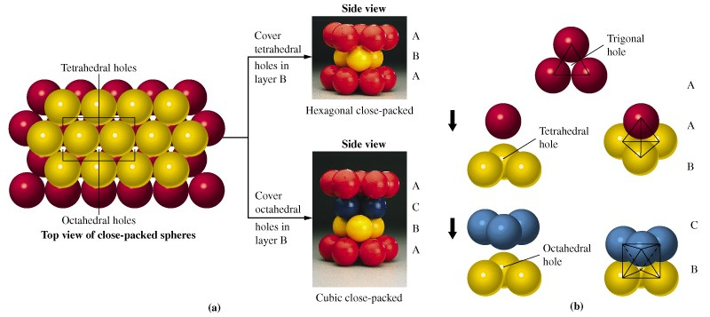
Holes in Crystals

Slide 33
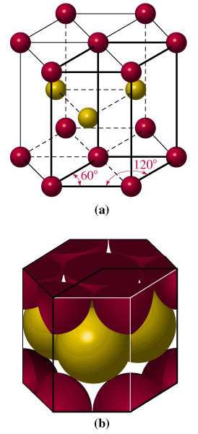
Hexagonal Close Packed (hcp)

Slide 34
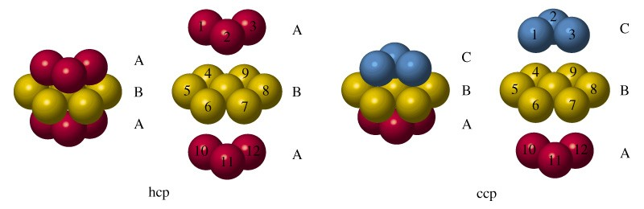
Coordination Number

Slide 35
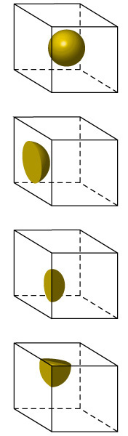
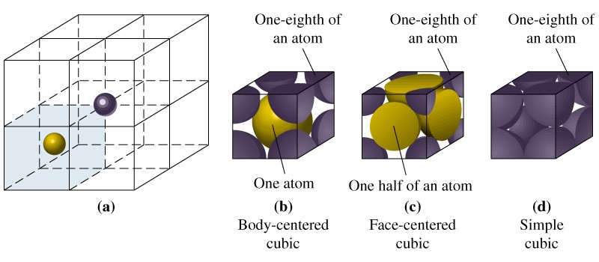
Counting Cell Occupancy

Slide 36
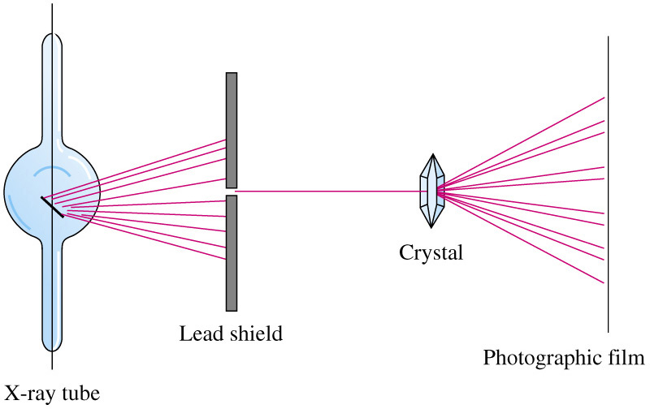
X-Ray Diffraction

Slide 37
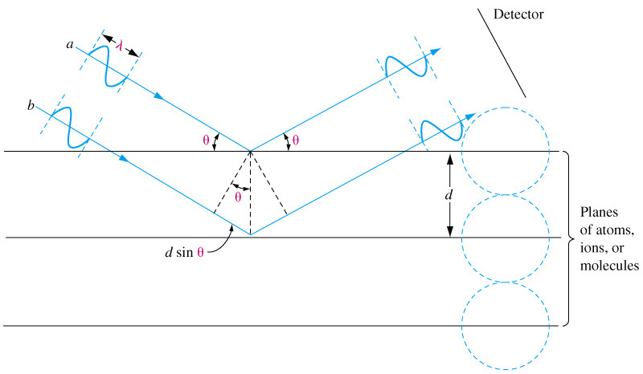
X-Ray Diffraction

Slide 38
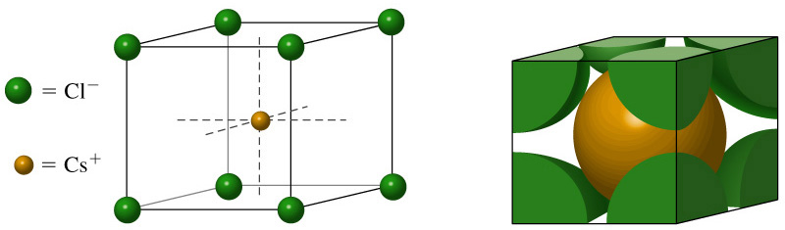
Cesium Chloride

Slide 39
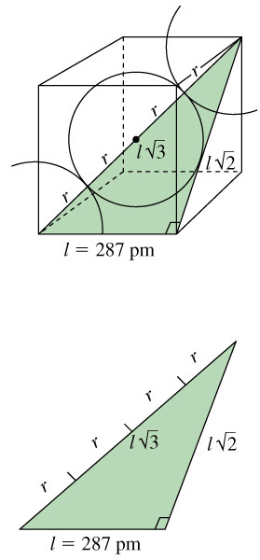
Atomic Radii from Crystal Structures

Slide 40
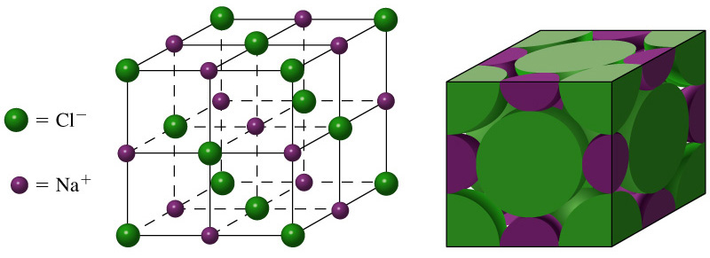
Sodium Chloride

Slide 41
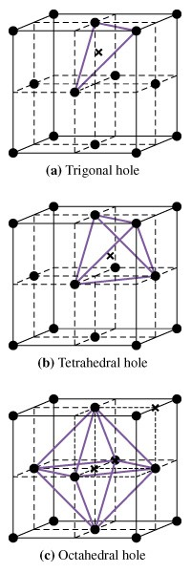
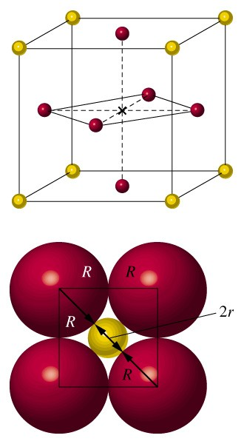
Holes in Crystals

Slide 42
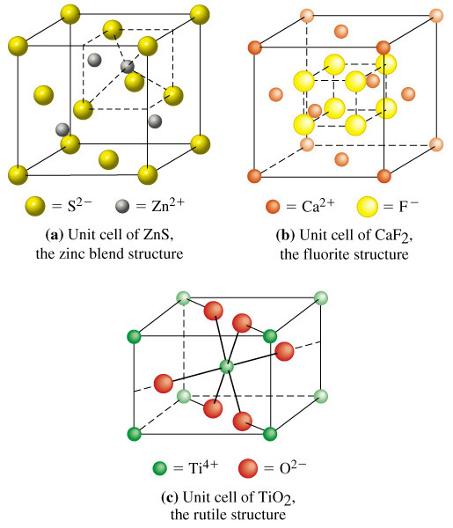

Slide 43

13-9 Energy Changes in the Formation of Ionic Crystals

Slide 44
Chapter 13 Questions
1, 3, 4, 13, 24, 26, 31, 45, 52, 61, 94, 107

